Slide 1
Burrows-Wheeler Transform
Slides by: Stephen Guest

Slide 2
Learning Objectives
To learn how to transform a sequence using Burrows-Wheeler transformation
To learn how to revert a BWT sequence back to its original state

Slide 3
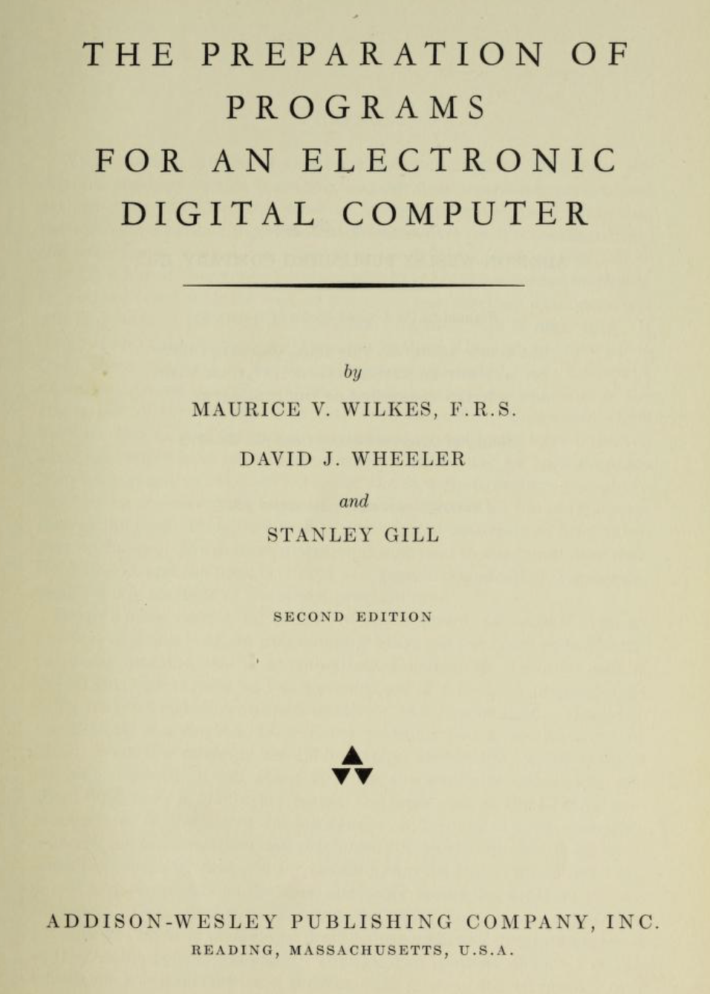
David Wheeler and the Burrows-Wheeler Transform
BWT was originally discovered by David Wheeler
Wheeler is credited as having achieved the world’s first PhD in computer science in 1951 from Cambridge in England
Created the first programming language that allowed users to program a computer in something besides binary code
Credited along with Maurice Wilkes and Stanley Gill as the inventor of the subroutine (aka function) in computer programming
Co-authored possibly the first ever book on computer programming
In the early 1980s, Wheeler was working on the problem of string compression as a consultant for Bell Labs
This is when he discovered the Burrows-Wheeler Transform
Didn’t publish it until 10 years later with the help of one of his students, Michael Burrows

Slide 4
The Burrows-Wheeler Transform
The Burrows-Wheeler transform (BWT) is a permutation of a target string
The BWT has 3 interesting and useful properties:
It tends to organize a string that contains repeats into runs of consecutive characters
x=GCTACATTACATACATACATAC CTTTTTCCCCAAAAAG$AAATCA
BWT(x)
Run-length encoding
C5T4C5AG$3ATCA
Recall that the human genome has many repeats

Slide 5
The BWT is invertible i.e. given the BWT of a string you can recover the original string without any additional information
x=GCTACATTACATACATACATAC CTTTTTCCCCAAAAAG$AAATCA
The BWT can be used as an index for fast pattern matching
BWT(x)

Slide 6
Generating the Burrows-Wheeler Transform of a Sequence
An example sequence: GCTACATTACATACATACATAC
Notice that like the genome, this sequence contains a repeated sequence (TAC)
GCTACATTACATACATACATAC
GCTACATTACATACATACATAC$
CTACATTACATACATACATAC$G
To obtain the Burrows-Wheeler Transform (BWT):
Add the $ character to the end of the string
Perform all cyclic rotations of the string
TACATTACATACATACATAC$GC
ACATTACATACATACATAC$GCT
CATTACATACATACATAC$GCTA
ATTACATACATACATAC$GCTAC
TTACATACATACATAC$GCTACA
TACATACATACATAC$GCTACAT
ACATACATACATAC$GCTACATT
CATACATACATAC$GCTACATTA
ATACATACATAC$GCTACATTAC
TACATACATAC$GCTACATTACA
ACATACATAC$GCTACATTACAT
CATACATAC$GCTACATTACATA
ATACATAC$GCTACATTACATAC
TACATAC$GCTACATTACATACA
ACATAC$GCTACATTACATACAT

Slide 7
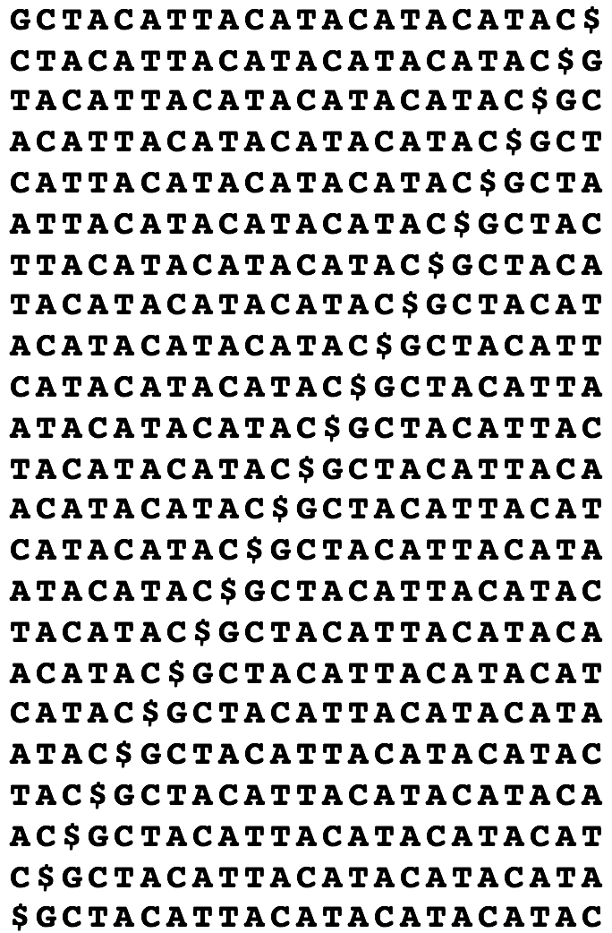
Matrix of all cyclic rotations of our example string: GCTACATTACATACATACATAC$
Some things to note about this matrix:
The matrix contains the suffix array of the original string
Every column contains the same set of characters which are all of the characters in the original string
Characters in the last column directly precede characters in the first column

Slide 8
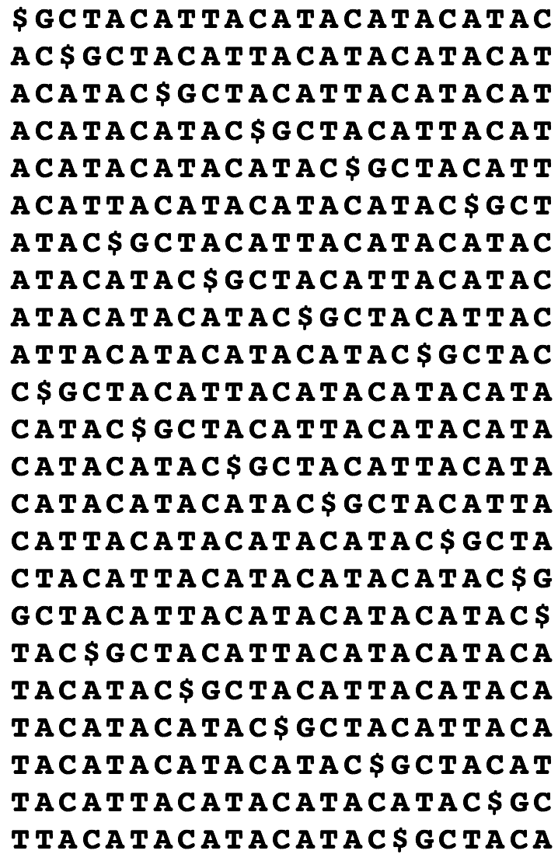
Matrix of All Cyclic Rotations
BWT Matrix
5Ts
Step 3:
Perform a Lexicographic sort of the cyclic rotations matrix
Lexicographic
Sort
4Cs
5As
(Lexicographic Sort = Alphabetical sort)
3As
The Burrows Wheeler Transform is the last column of the sorted matrix:
CTTTTTCCCCAAAAAG$AAATCA
Data Compression! Size of BWT for Human Genome~750MB
C5T4C5AG$3ATCA
Run-length encoded

Slide 9
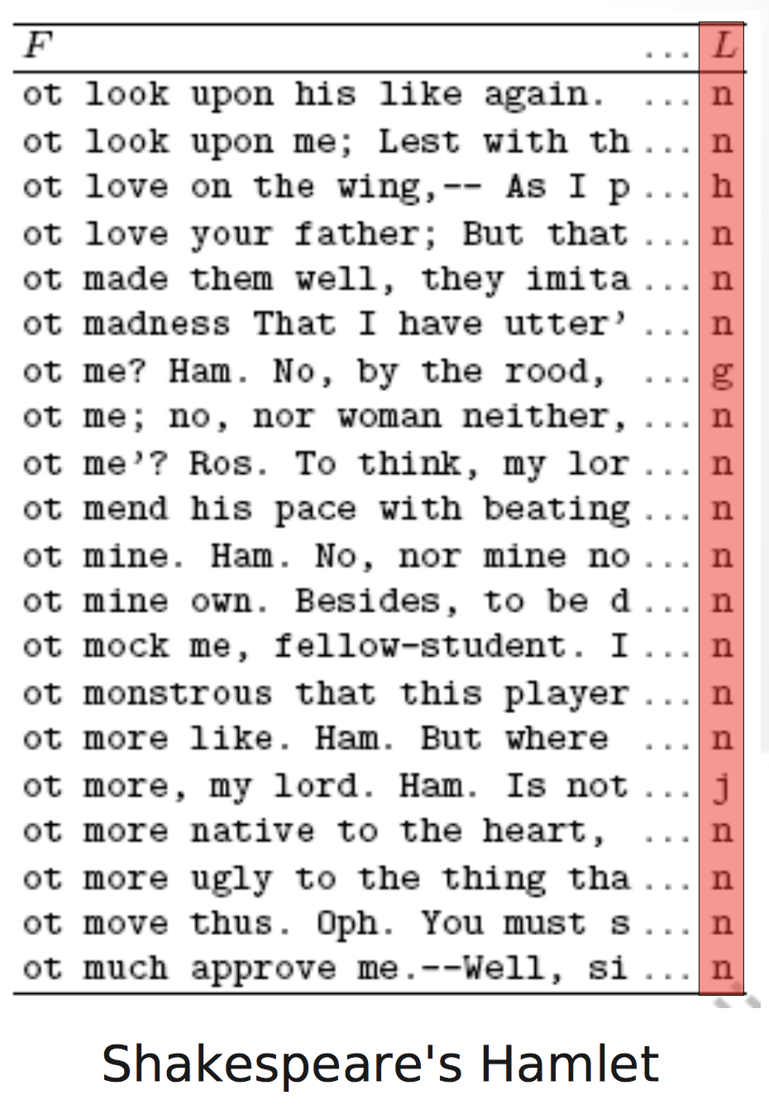
BWT Matrix for Shakespeare’s Hamlet
In the Burrows, Wheeler 1994 manuscript they performed a Burrows-Wheeler Transform of the entire text of Shakespeare’s Hamlet
Like the human genome, the english language contains many repeats i.e. common words.
For example, ‘not’ is a common english word
Shown here is a subsection of the BWT matrix for Shakespeare’s Hamlet
Specifically, we’re looking at rows that begin with ’ot’
Because ’not’ is a common english word, and the BWT matrix contains cyclic rotations, the final column for these rows often contains the letter ‘n’

Slide 10
Interesting Properties of the Burrows-Wheeler Transform
It tends to organize a string that contains repeats into runs of consecutive characters
The BWT is invertible i.e. given the BWT of a string you can recover the original string
The BWT can be used as an index for fast pattern matching

Slide 11
Inverting Burrows-Wheeler
How can we recover the original string using just the BWT?
Original String =
T
A
C
A
$
GCTACATTACATACATAC
So, since $ is the last character, the previous character must be a ‘C’. Since this is the 1st occurrence of C in the last column, it matches to the 1st occurrence of C in the first column, which then is matched to an ‘A’ in the last column
Step 1: We know the string ends in $
Step 2: Recover the first column of the BWT matrix.
The BWT contains all of the characters that are in the 1st column
The matrix is sorted lexicographically
Therefore the first column is just a lexicographic sort of the BWT transform
This ‘A’ is the 1st occurrence in the last column, so it is matched to the 1st occurrence of ‘A’ in the first column, which is followed by a ‘T’. And so forth….
Step 3: Use the Last-First (LF) property to recover the rest of the string
The LF property states that the k-th occurrence of a character in the last column of the BWT matrix is equivalent to the k-th occurrence of that character in the first column

Slide 12
Interesting Properties of the Burrows-Wheeler Transform
It tends to organize a string that contains repeats into runs of consecutive characters
The BWT is invertible i.e. given the BWT of a string you can recover the original string
The BWT can be used as an index for fast pattern matching

Slide 13
Pattern Matching With Burrows-Wheeler
Target = GCTACATTACATACATACATAC$
Query = ATTA
There are 5 occurrences of T preceding A
Starting from the end of the Query use the last first property
Query ends in TA so can we find occurrences of T preceding A?
LF property tells us that these Ts which are the first 5 Ts in the last column are equivalent to the first 5 Ts in the first column
We found ATTA so it must exist in the original string, but where is it located in that string?
There is 1 occurrence of a T preceding a TA
There is 1 occurrence of an A preceding a TTA

Slide 14
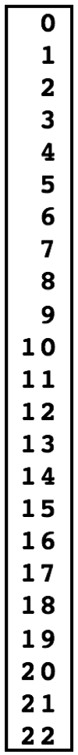
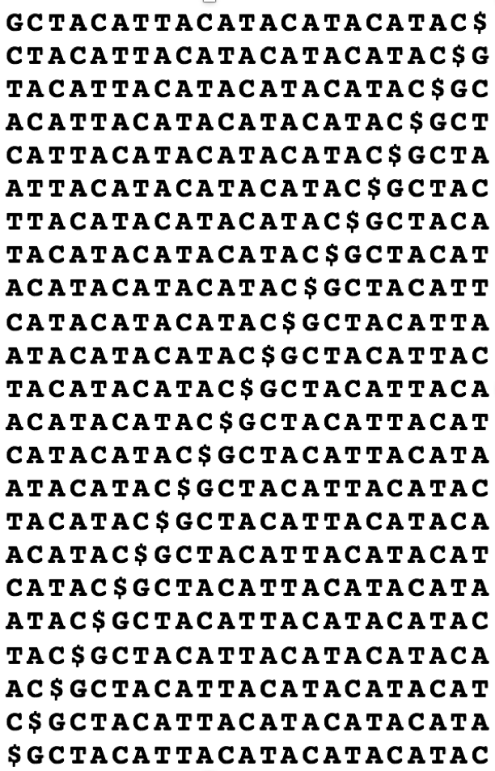
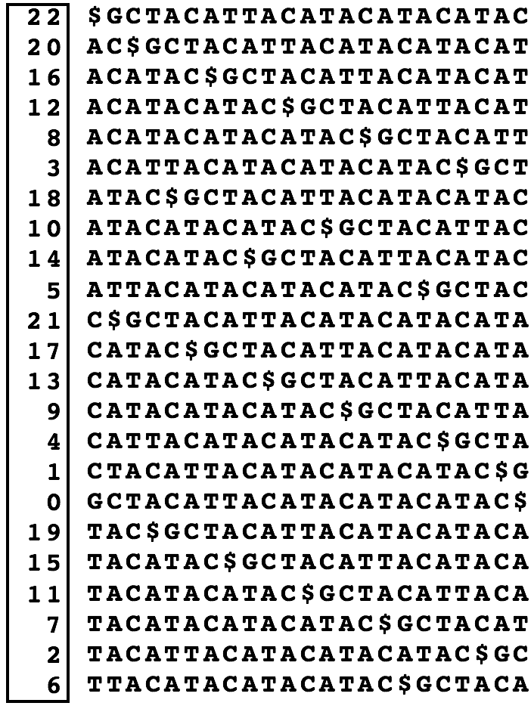
In order to determine where a match is in the original string, we have to store some additional information
The additional information we need is the Suffix Array (SA) Index
To get the SA Index, we go back to the matrix of all cyclic rotations of our target string
If we assign an index before sorting, this is the SA Index
We keep this information through the sort
SA Index
All Cyclic Rotations Matrix
BWT Matrix
Lexicographic
Sort
012345
Target = GCTACATTACATACATACATAC$

